Slide 1
Lead Generation for X Education
By Linus Jen

Slide 2
Table of Contents
01
Problem Statement
03
Technical Details
02
Solution
04
Application & Limitations

Slide 3
01
Problem Statement
Improving conversion rates to increase sales

Slide 4
Problem
The CEO of X Education, a company selling online courses to industry professionals, wants to improve sales by improving lead quality. He has tasked the team to improve their conversion rate from 35% to 80%.

Slide 5
02
Solution
Apply ML model to target prospects

Slide 6
Solution
Given the survey results for those who have created an account with X Education and their decision to convert, I built a classification model with high metrics (95% accuracy, recall, and F1).

Slide 7
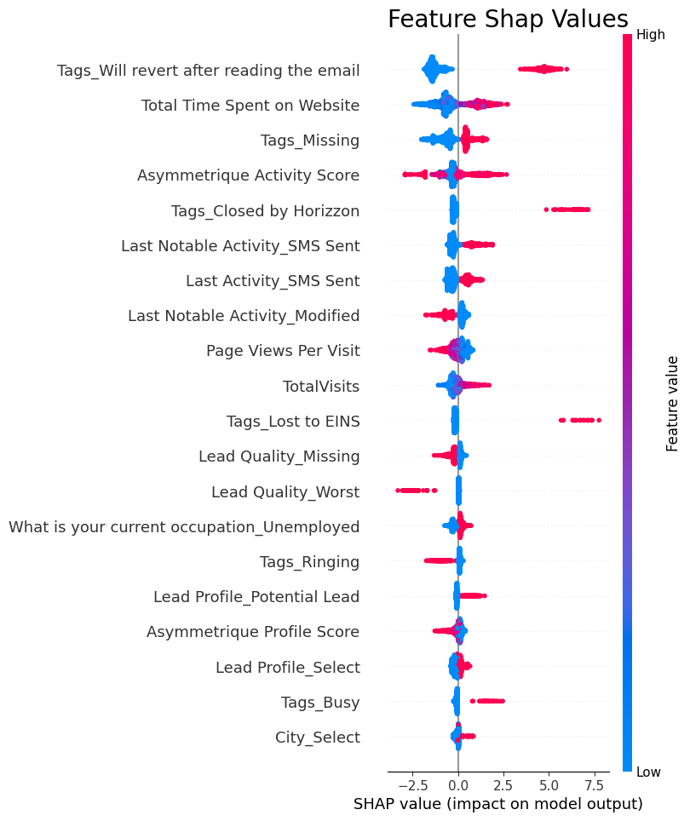
Feature Importance
Shap values give insight to black box models by showing prediction tendencies
Tags describe attributes about a potential customer
Last (Notable) Activity shows the last interaction a customer had with the website or company
Customer actions (time spent on website, activity scores, page views per visit, etc.) seem to dictate desire of product

Slide 8
Prospect Profile
High interactions with website (spend lots of time on website, have high magnitude for asymmetrique activity scores, and visit our site often)
Look for particular tags (those who would revert after reading the email, missing tags, closed by Horizzon(?), lost to EINS(?)
Last (Notable) Activity of SMS sent by the user also tends to improve the likelihood of converting
Avoid: those who have many page views per visit, missing / worst rated leads, or their Last Notable Activity was modified

Slide 9
Potential Growth
Expand to other countries
People from India made up over 90% of observations
Certain types of students (Dual Specialization and Lateral) have seen high number of conversions in small samples
Potentially do outreach to specialized schools? Sponsor hackathons, provide courses, etc.?

Slide 10
03
Technical Detail
Procedural review for non-stakeholders

Slide 11
Data Preprocessing
Removed 13 features with low variance
EX: `Do Not Call` was filled with mostly False (2 True’s)
Combined categories with low # of observations
EX: `Countries` with under 50 total observations were aggregated into one group
Imputed `Missing` for categorical variables and 0 for numerical variables
Missing data had unique proportions for conversions, as compared to other groups
SMOTE (oversampling minority classes) and undersampling
Used to address class imbalances

Slide 12
Model Building
Final preprocessed data (after one-hot encoding): 108 columns
Split data into train / validation / test sets of 70/15/15
XGBoost was the only model tested due to time constraints
Accuracy, weighted precision all 0.95, weighted recall 0.93
Final model: XGBoost with feature selection (81 columns)
Accuracy = 0.95, weighted precision 0.94, weighted recall 0.93

Slide 13
04
Application & Limitations
Pilot plan & assumptions

Slide 14
Pilot Plan
01
02
03
Treatments
Compare
Decide
Split all prospects into two groups – one following existing method, and another recommended by model
After trial period, run a two sample t-test to test of improvement of conversion rate
Determine whether or not to implement model

Slide 15
Limitations - Data
Dataset is limited to questionnaire responses after signing up to website. Assumes truthful responses
No data is present for characteristics of a prospect’s online presence (interests, age, etc.)
Model only targets those who have already signed up to X Education – existing lead generation strategy not shared

Slide 16
Limitations - Procedure
Only XGBoost was tested in the modeling process (without hyperparameter tuning)
Given model success, did not change the threshold at which a prospect would be predicted as likely to convert
Difficult to test model generalizability when data is limited to people who have already signed up to the website

